Slide 1


MONITORING THE OIL PRICE, CORRELATE WITH THE GOLD PRICE, AND FIND OUT THEIR CORRELATION.
LIU,HONGYANG 17201091/1

Slide 2
Objective
In this project, the main purpose is to find
out the correlation between the gold price and oil price. We would utilize
python and it is powerful libraries to verify our hypothesis and evaluate their
relevance.

Slide 3
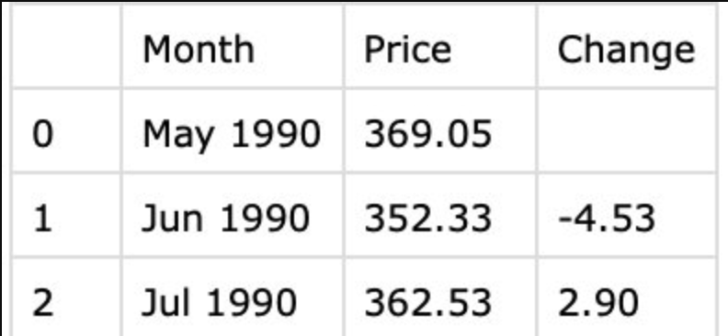
Data sets
1. The month represents data
2. The price is the quantity of the commodity price.
3. The change is the change rate that the current month value changed compared with las month
https://www.indexmundi.com/commodities/?commodity=crude-oil&months=360

Slide 4
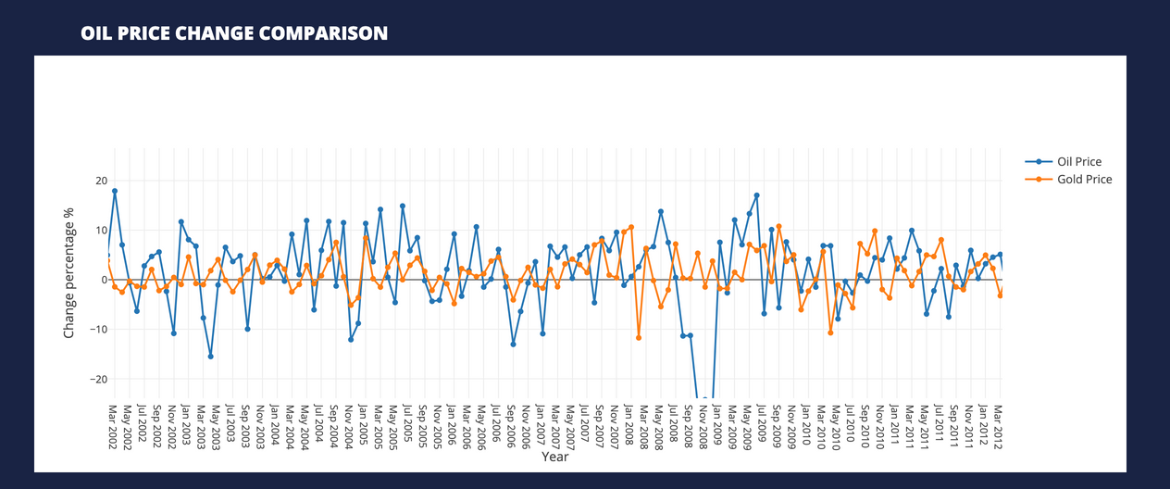
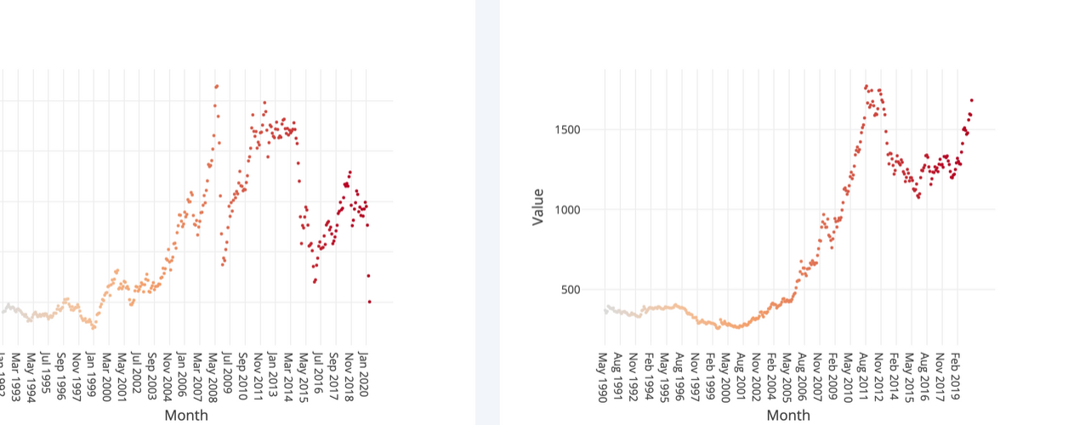
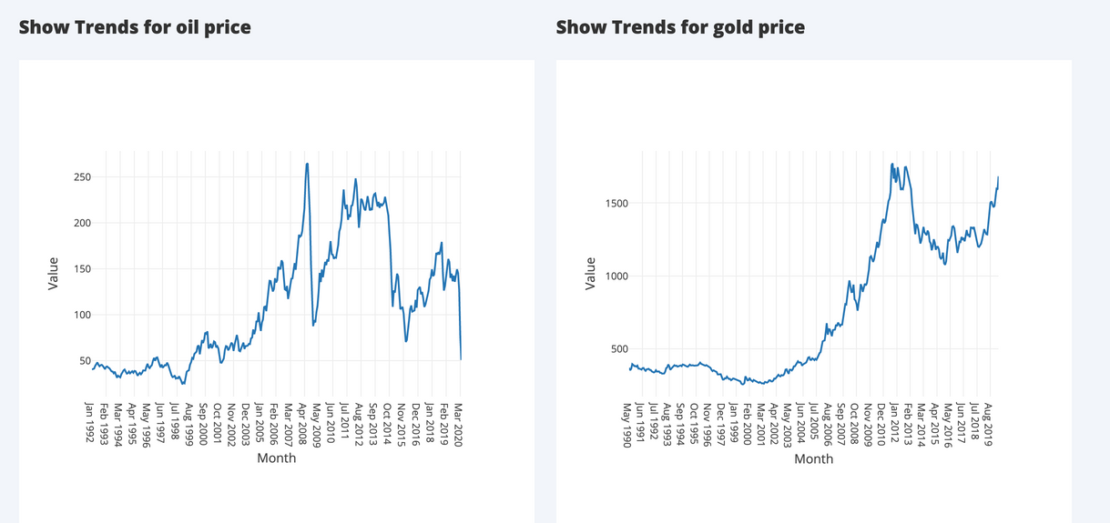
Website Address:
https://mighty-ridge-02940.herokuapp.com/

Slide 5
Conclusion
From the above work, we have found that the oil price had a positive correlation with gold prices from 1992 to 2008. During that time, the oil price increased rapidly and the gold price had also shown similar trends.
While during 2008 till 2013, the oil price first drops dramatically and then soared to around 250 dollars. The gold price was still increased during that time. The last phase is from 2013 till now, the oil price has fluctuated, but the gold price has increased to the peak.

